Slide 1
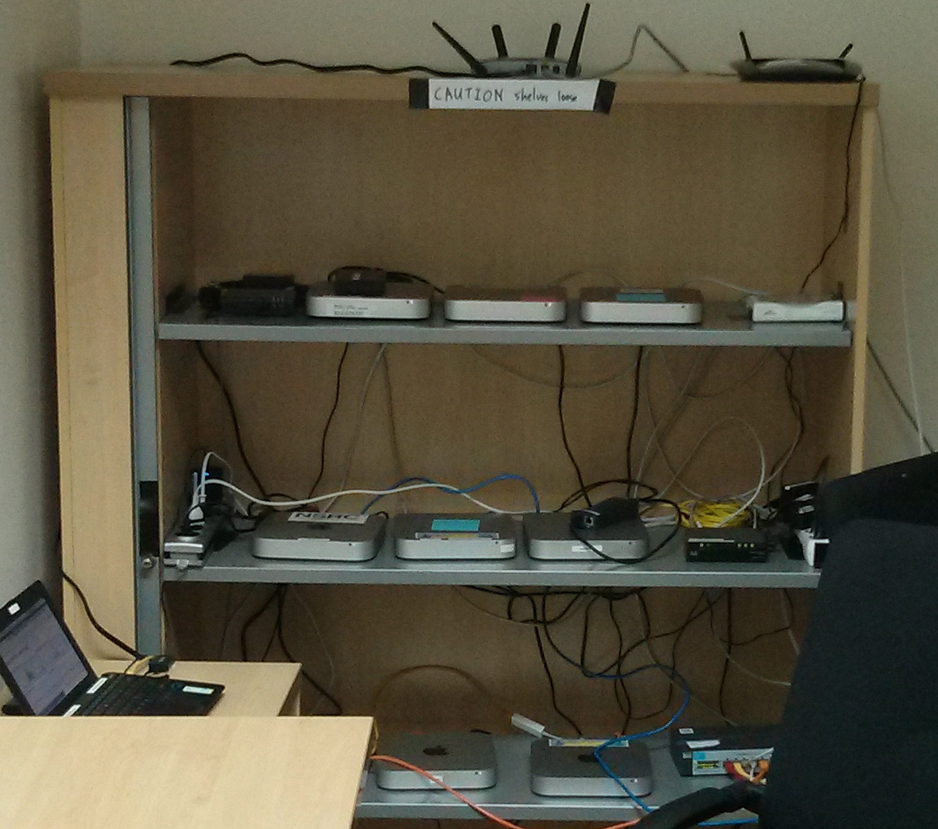
Virtualization Overview
Isabel Odida
AFNOG SS-E 2018

Slide 2
What are we using this Year?
NUC servers
Intel core i5 quad core 8 hyperthreads
32GB of ram
2 x 256GB SATA SSD
A pretty hefty server
Less than $2k
Drawbacks
One psu
OOB is kind of a pain
Ubuntu 14.04 / KVM

Slide 3
What is it?
Virtualization is the abstraction of the manifestation of a resource from the actual physical instance of that resource.
What Computing/Network resources can be virtualized?
Virtually anything! :)

Slide 4
Anything?
In the context of this course. We're interested in virtualization along two dimensions:
Services
Hosts

Slide 5
Resource/Service virtualization
Examples:
Load-balancers
DNS Based GLB
HTTP(S) Virtual Hosting
MX records
Virtual Switches
Virtual Routers
Virtual Firewalls

Slide 6
Resource Virtualization - Continued
HTTP virtual hosts
Multiple websites on one system
Load Balancing
One (or many sites or applications) across many systems
Can be done at Layer-3/4/7

Slide 7
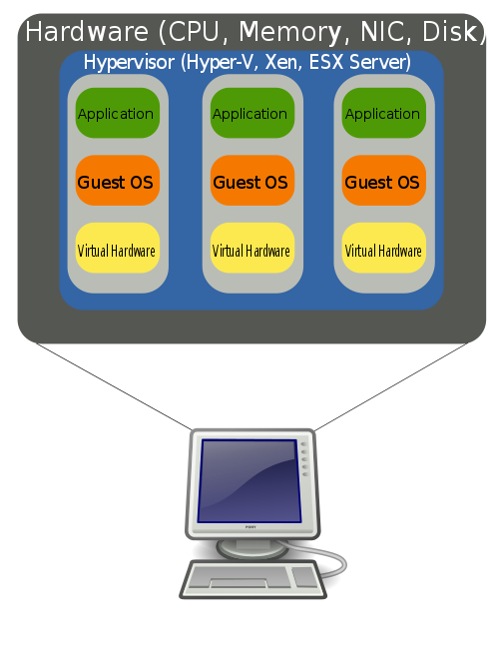
Host Virtualization
Examples
VMware
KVM (Used in class)
Virtual-Box (Simplest to use)
XEN
FreeBSD and Linux Jails
Windows Hyper-V
LXC/D (I shall never recommend)
Proxmox

Slide 8
What problem are we attempting to solve with host virtualization.
Problem 1 – Idle capacity.
Most of the machines in your datacenter are idle most of the time.
Capacity you're not using:
Cost money up front
Cost money to operate
Reduces you return on capital
Packing discreet systems into a smaller number of servers provides savings along virtually every dimension.

Slide 9
Problems - Continued
Problem 2 – Provisioning
Spinning up a new service involves:
Acquiring the hardware
Building the server
Integration with existing services
With virtualization we're aiming to short-circuit that
Capacity is a resource
Machine instances may be cloned or provisioned from common basic images
Resources are purchased in bulk and assigned to applications as necessary.

Slide 10
Problems - Continued
Problem 3 – Hardware abstraction
Operating systems, servers, and applications evolve at different rates.
Providing a common set of infrastructure resources means, virtualized systems are portable across servers
Hardware failure can more easily be managed.
Abstraction may come at a performance cost however. (some workloads are more expensive than others)
See: http://blog.xen.org/index.php/2011/11/29/baremetal-vs-xen-vs-kvm-redux/

Slide 11
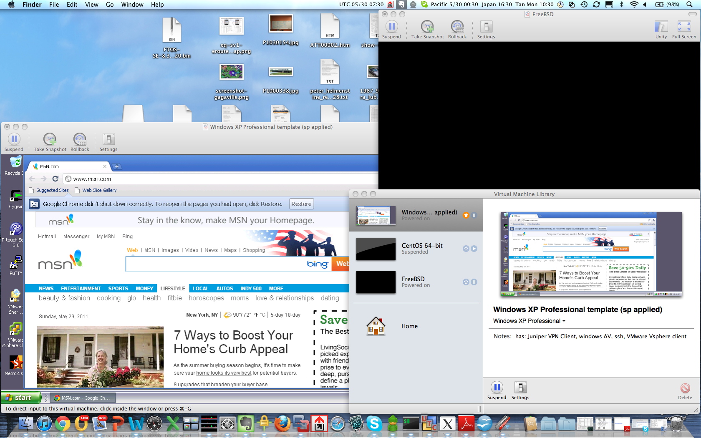
Examples – Desktop Virtualization

Slide 12
Desktop Virtualization
Uses
Prototyping services or applications before deployment
Utilities that don't run on your operating system
Maintaining multiple versions of an environment for support purposes.
Staying familiar with unix while running windows (consider compared to the alternative (dual-booting)
Issues
Emulating multiple computers on your laptop/desktop is somewhat resource intensive
Vmware player and VirtualBox are free.
http://www.virtualbox.org/wiki/Downloads
https://my.vmware.com/web/vmware/downloads

Slide 13
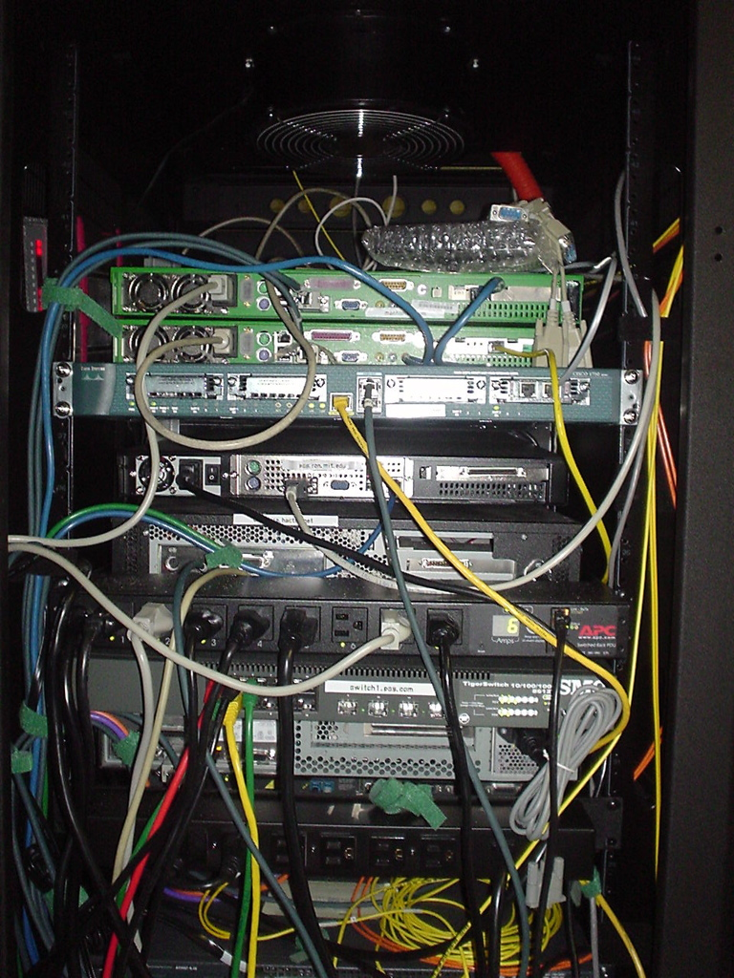
Examples – Server Virtualization

Slide 14
Virtualized Servers as a Service (Amazon Web Services)
Much as collocated servers, are available from a hosting provider, virtual servers are also available.
Model is:
You pay for what you use.
Flexibility, need fewer servers today than you used, yesterday.
Leverage other amazon tools (storage/map-reduce/load-balancing/payments etc)

Slide 15
AWS Steps
Select availability zone
Launch new instance
Select appropriate ami
Associate with ssh key
Launch instance
Add ip
SSH into new machine instance.
t1-micro-instances run $54 a year + bandwidth

Slide 16
Try it for free...
Free tier for the first Calender year is (per month):
750 hours of EC2 running Linux/Unix Micro instance usage
750 hours of Elastic Load Balancing plus 15 GB data processing
10 GB of Amazon Elastic Block Storage (EBS) plus 1 million IOs, 1 GB snapshot storage, 10,000 snapshot Get Requests and 1,000 snapshot Put Requests
15 GB of bandwidth in and 15 GB of bandwidth out aggregated across all AWS services
Which is not to say that, at scale EC2 is particularly cheap, (It isn't)
Limited capital at risk is in the context of prototyping or experimentation however.

Slide 17
AWS - Continued
For provisioning purposes cli interaction is possible:
http://aws.amazon.com/developertools/351
Along with tools to support the provisioning and destruction of virtual machines.

Slide 18
Provisioning and management
Is the glue that makes virtualization usable
In commercial virtualization environments the provisioning/management toolkits represent the bulk of the licensing cost (VMware) and the secret sauce (VMotion, disaster recovery, backup, etc)
Examples:
XEN tools – a collection of perl scripts for spinning VMs http://www.xen-tools.org/software/xen-tools/
KVM tools - http://www.linux-kvm.org/page/Management_Tools
Cloud.com/cloud-stack (orchestration) - http://www.cloudstack.org/
Rightscale – (orchestration multiple public/private clouds) http://www.rightscale.com
Puppet (host / configuration management) - http://puppetlabs.com/puppet/
PDSH – (Parallel Shell execution) http://code.google.com/p/pdsh/

Slide 19
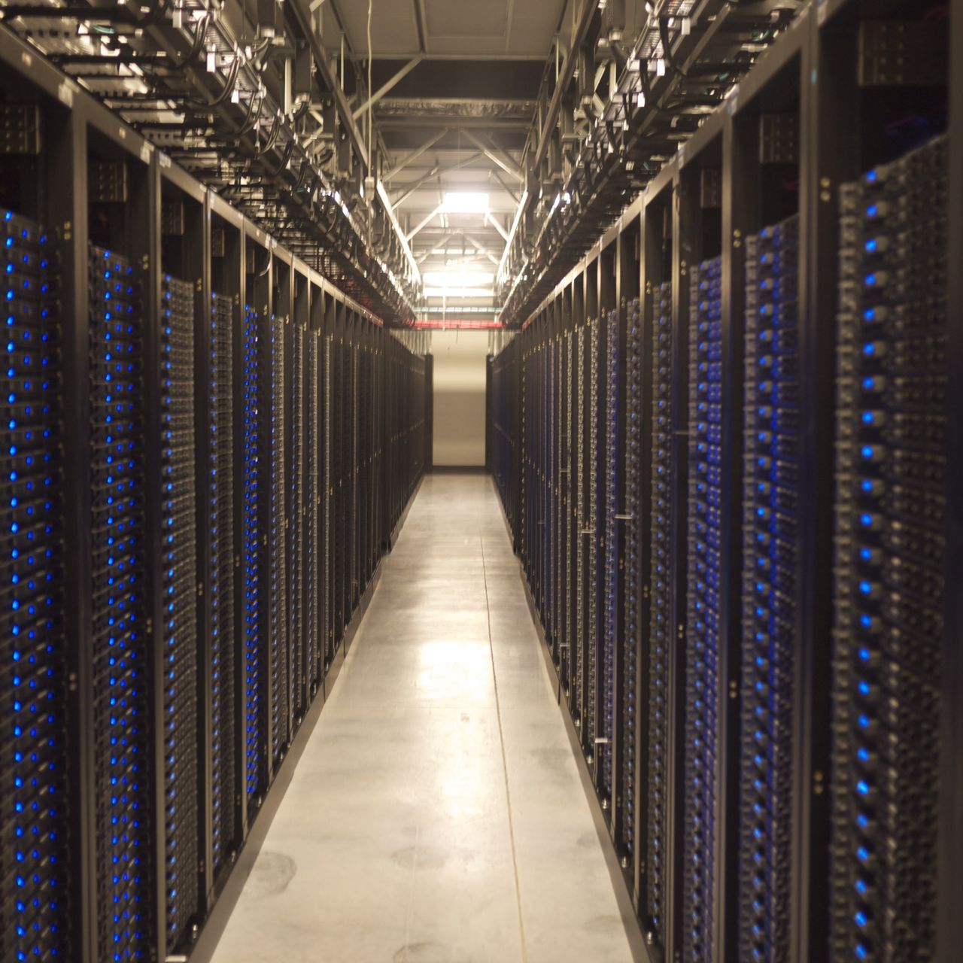
Can you spot the...
Web-node?
Database-node?
Load-balancer?
Nameserver?
DHCP Server?
Email cluster?
Devnodes?

Slide 20
Complimentary technologies
NIC teaming or Link aggregation
Network attached storage and network centric filesystems
NFS
Hadoopfs
GFS2
Distributed databases
Example mysql cluster
Couchbase/Membase
OracleRAC

Slide 21
KVM Installation
http://ws.afnog.org/afnog2018/sie/setup/virtualising/virtualising-sie-howto.md.html

